Slide 1
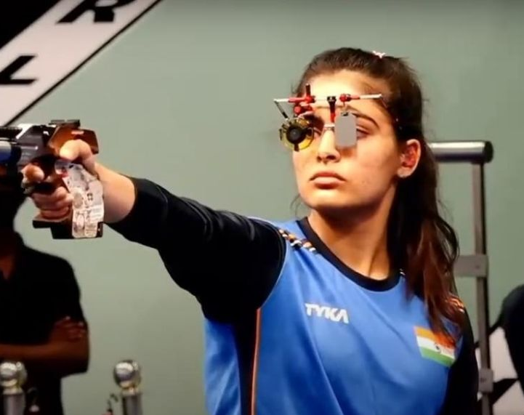
Flow & Visualization
In sports
https://www.ted.com/talks/diane_allen_how_to_find_flow_and_lose_yourself_in_it
Manas K Mandal

Slide 2
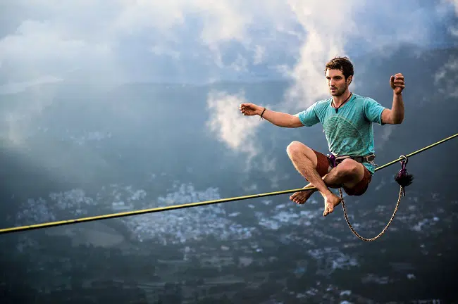
The flow state
The flow state is the experience of being so absorbed by an engaging, enjoyable task that your attention is completely held by it
A state in which a person is completely focused on a single task or activity
The idea behind flow originated from the sports psychology theory about an Individual Zone of Optimal Functioning

Slide 3
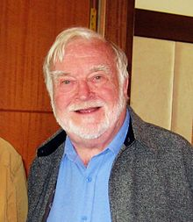
The Flow state
Flow is the melting together of action and consciousness, being in the zone or locked in
The state of finding a balance between a skill and the challenge in the task
You generally lose sense of time, self-consciousness, and anything that doesn't have to do with
Mihaly Robert Csikszentmihalyi

Slide 4

Hyperfocus
Flow is different from hyperfocus (hyperfocus can "capture" a person, perhaps causing them to appear unfocused like playing videogames)
Hyperfocus can be a natural consequence of ADHD, which is characterized by a lack of control over attention

Slide 5
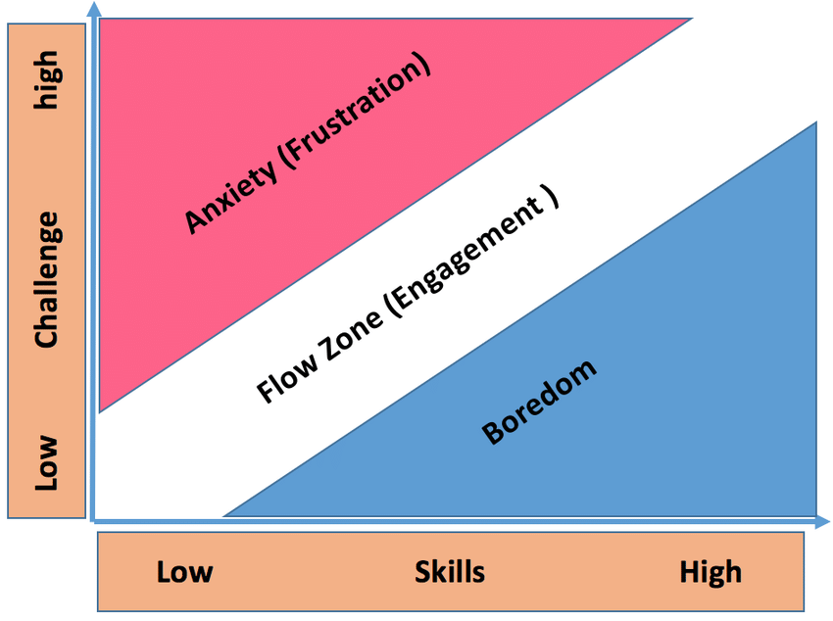
Flow theory postulates
The activity must have clear goals and progress
The task must provide clear and immediate feedback. This helps to negotiate any changing demands and allows adjusting performance to maintain the flow state
Good balance is required between the perceived challenges of the task and one's perceived skills.

Slide 6
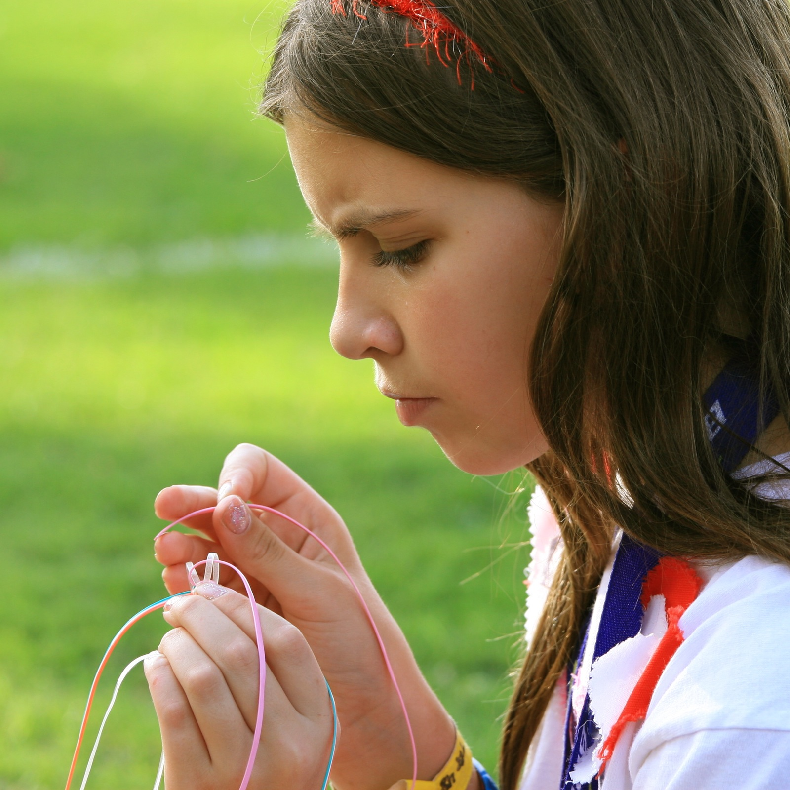
The experience of flow: Factors behind
Intense & focused concentration on the present moment
Merging of action and awareness, a loss of reflective self-consciousness
A sense of personal control or agency over the situation or activity
A distortion of temporal experience, as one’s subjective experience of time is altered
Experience of the activity as intrinsically rewarding, also referred to as autotelic experience

Slide 7
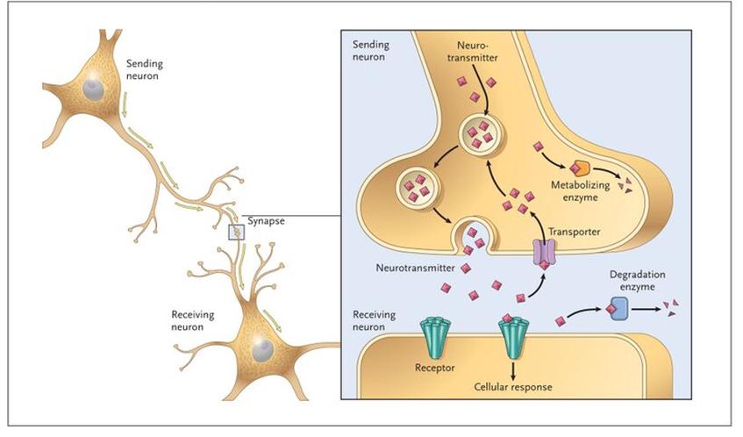
Flow & neurotransmitters
Noradrenaline: Speeds up heart rate, improves tension, triggers the release of glucose giving you more energy.
Dopamine: Gives you the feeling of engagement in a task, excitement, adventure... and rewards you for it.
Endorphin: This pain-relieving and 'euphoria-generating' neurotransmitters
Anandamide: Sanskrit word ananda, meaning bliss, joy or delight. It lifts mood, dilates blood vessels, bronchial tubes (aiding in breathing), inhibits our ability to feel fear
Serotonin: found in the gastrointestinal tract. It affects mood, social behaviour, appetite, digestion, sleep, memory

Slide 8
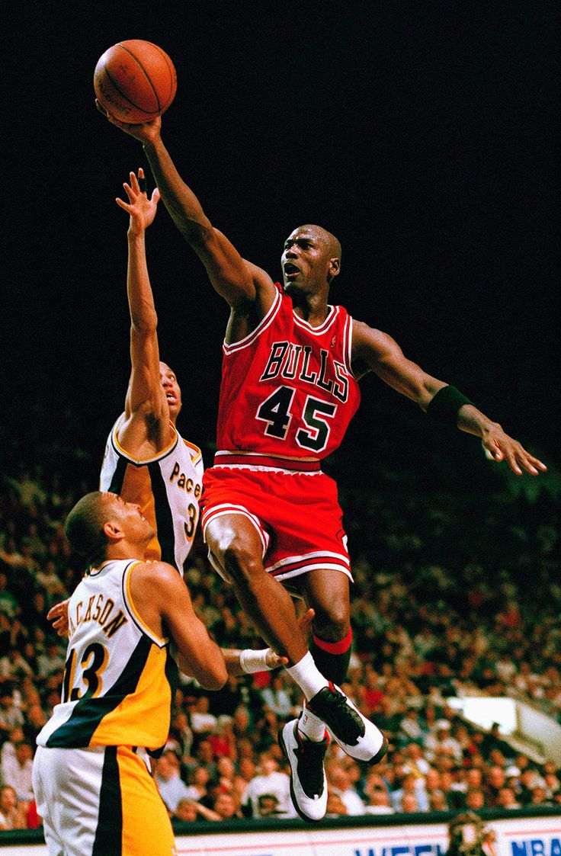
Case Study 1: Michael Jordan
Arguably the greatest basketball player of all time, Michael Jordan's career was punctuated with moments that seemed superhuman. Observers often noted how Jordan seemed to play as if time had slowed down for him.
Quotes and Observations:
"When I'm in the zone, I don’t think about the game... the game just comes to me... and everything else is just blocked out." - Michael Jordan.
Studies and Analysis:
A study by Jackson and Csikszentmihalyi found that elite athletes, like Jordan, often experience Flow when the challenge of the game matches their skill level, leading to peak performances.

Slide 9
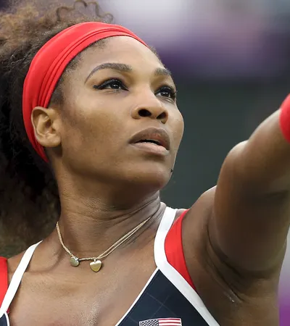
Case Study 2: Serena Williams
Serena Williams has displayed moments of unparalleled prowess on the court. Her ability to maintain composure and deliver under pressure is a testament to her frequent encounters with Flow.
Quotes and Observations:
"When I'm out there, and I'm in the zone, I don’t think about anything else... just my game, and my next move." - Serena Williams.
Studies and Analysis:
A study by Swann et al. found that athletes in Flow, like Williams, were more likely to win medals in international competitions. The study also highlighted the importance of a supportive team environment in facilitating Flow.

Slide 10
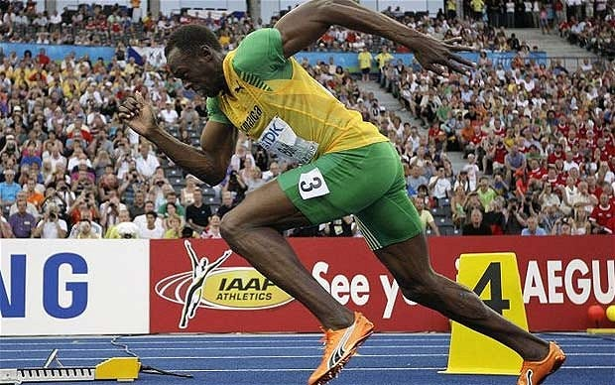
Case Study 3: Usain Bolt
The fastest man on Earth, Usain Bolt's record-breaking sprints are a blend of physical prowess and mental alignment. His races, though mere seconds long, are a vivid display of Flow.
Quotes and Observations:
"You don’t think about the start of the race, or the finish, or the crowd. You just run." - Usain Bolt.
Studies and Analysis:
Research by Young and Pain suggests that athletes in short-duration, high-intensity sports like sprinting often enter a state of Flow due to the sheer demand for focus and the immediate feedback the activity provides.

Slide 11
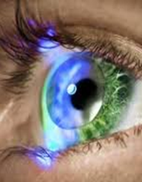
Visualization
When we visualize, try focus on something specific — an event, person, or goal we want to achieve — and hold it in our mind, imagining our outcome becoming reality
Visualization techniques involve creating a mental image or scenario in which you see yourself successfully performing a task or skill in your mind.

Slide 12

Theoretical foundations: guided imagery
Information processing model: mental imagery activates similar neural pathways as actual activity
Symbolic theory: …acts as a symbolic language. When athletes engage in practice, they mentally encode the desired actions, creating a symbolic representation of skill
Bio-informational theory: …involves the generation & manipulation of internal representations of sensory (visual, auditory, kinesthetic) & motor experiences, enabling the athlete to simulate the complete sensory experiences associated with desired performance
https://www.drdevroy.com/visualization-in-sport-and-exercise/

Slide 13
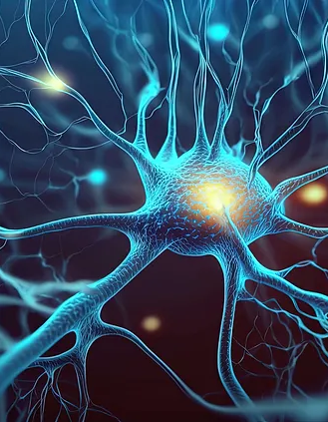
Neuroscience behind visualization
Visualization techniques engage the same neural pathways used during the actual physical execution of a sport, thereby strengthening motor skills without the physical wear and tear
The key is the brain plasticity; by consistently visualizing specific actions, athletes can mold their neural pathways to facilitate actual performance.
This brain-body connection means that by vividly imagining performing a task, you can effectively prepare your body to execute the action in reality.

Slide 14
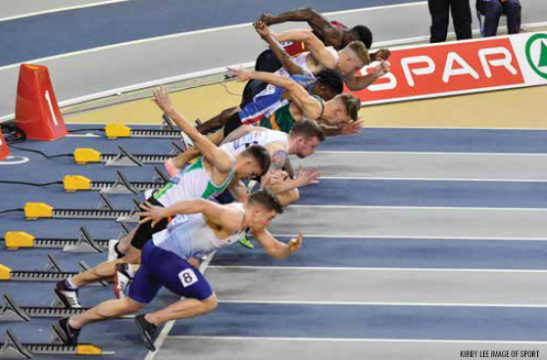
Types of Visualization Techniques
Process Visualization: This involves imagining the process of performing a task, including each step and movement required to execute the skill or strategy effectively.
Outcome Visualization: Athletes focus on visualizing the desired outcome, such as winning a race, scoring a goal, or achieving a personal best.
Motivational Visualization: This technique involves visualizing internal states or emotions, such as confidence, resilience, and the thrill of victory, to enhance motivation and mental toughness.
https://www.performancepsychologycenter.com/post/visualization-techniques-and-mental-imagery

Slide 15
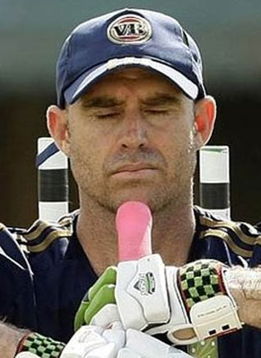
How to visualize?
Setting the Scene: Begin by finding a quiet, comfortable space … Close your eyes, take deep breaths to reach a state of calm
Creating the Visual: Imagine in detail including the environment, sounds, sensations, and emotions you associate with this setting
Executing the Skill: visualize yourself performing a specific skill or maneuver. See it in rich detail
Incorporating Emotion: Integrate emotional responses into your visualization. Feel the joy of success, the rush of adrenaline
Reinforcement: Repetition strengthens the neural pathways associated with visual skills

Slide 16
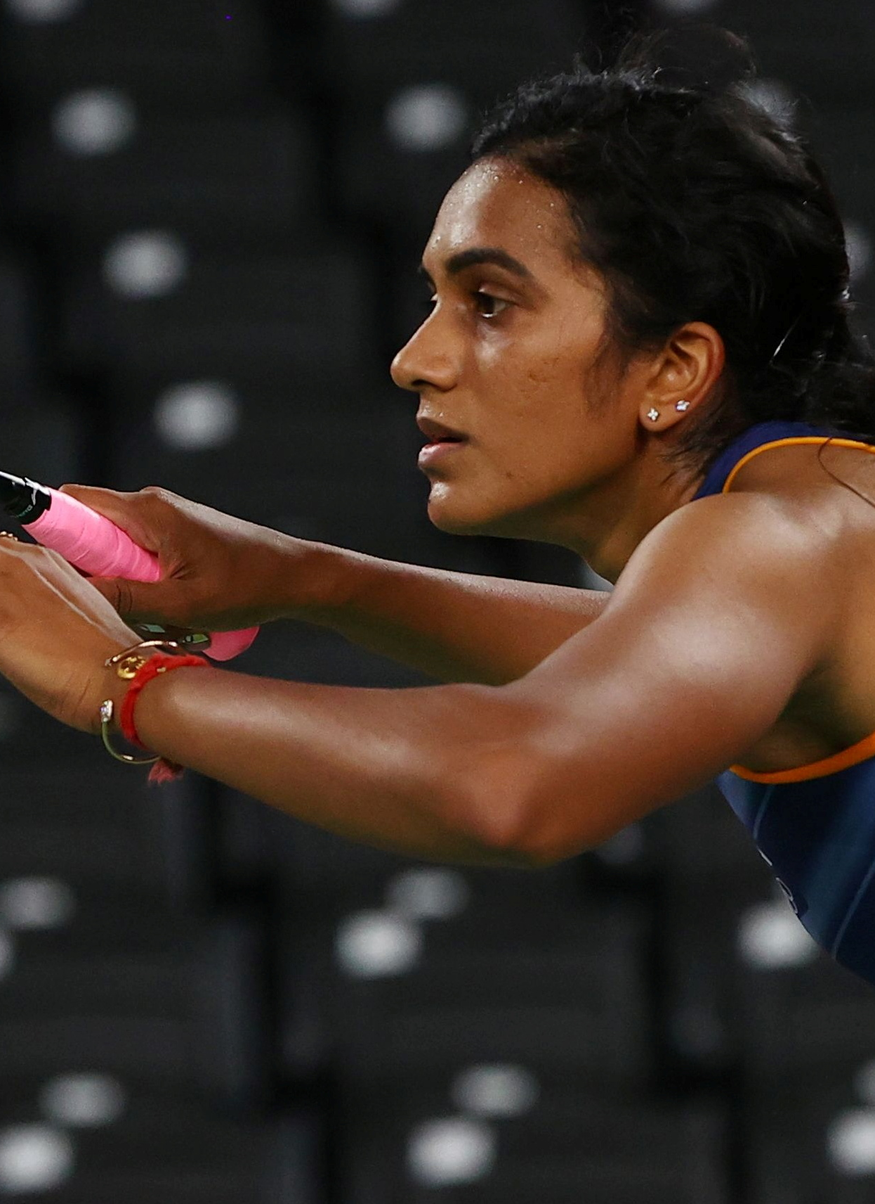
Key to quality mental imagery
Perspective: where the “imagery camera” is when you do imagery (seeing yourself from inside your body looking out)
Control: ‘you keep leaning in or sitting back? – that’s a control problem. Rewind the “imagery video” and edit it and rerun the imagery video until you do it correctly
Multiple senses: Good imagery is more than just visual
Speed: Slow motion (frame by frame) is effective in the beginning before reset to real-time
https://www.ted.com/talks/minda_dentler_what_i_learned_when_i_conquered_the_world_s_toughest_triathlon?geo=hi&subtitle=en

